Slide 1



Creating the Slovak Music Register for Coordinating Private and Public Data Infrastructure
DANIEL ANTAL, CFA

Slide 2


The case for a public-private partnership
100,000 sound recordings per day
100,000,000 music sound recordings
200,000,000 music sound recordings over 10+ years
●

Slide 3
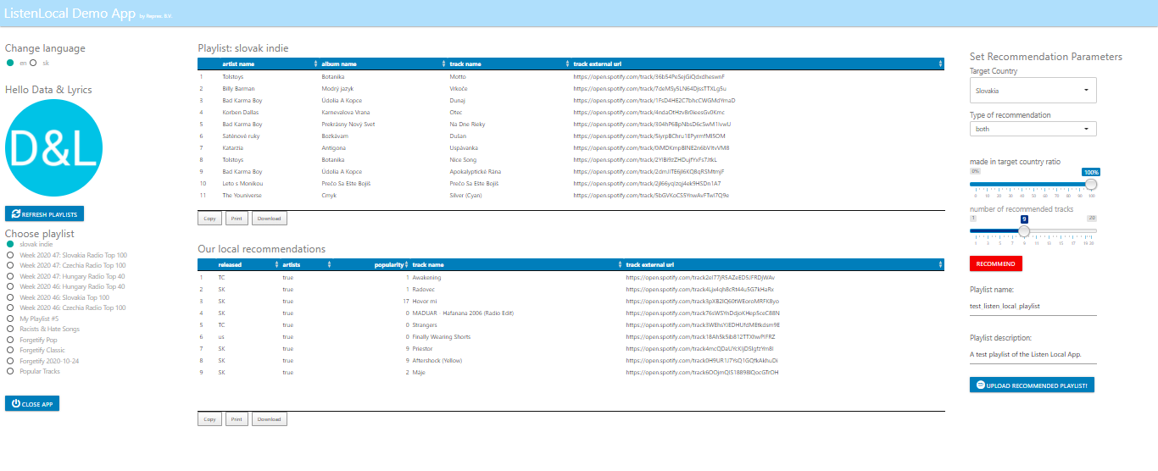




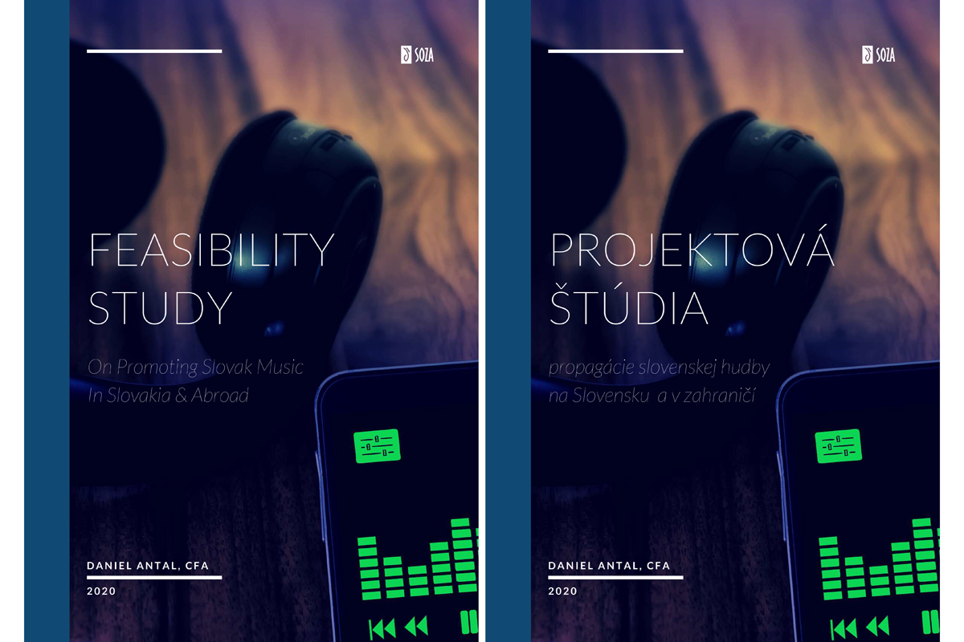


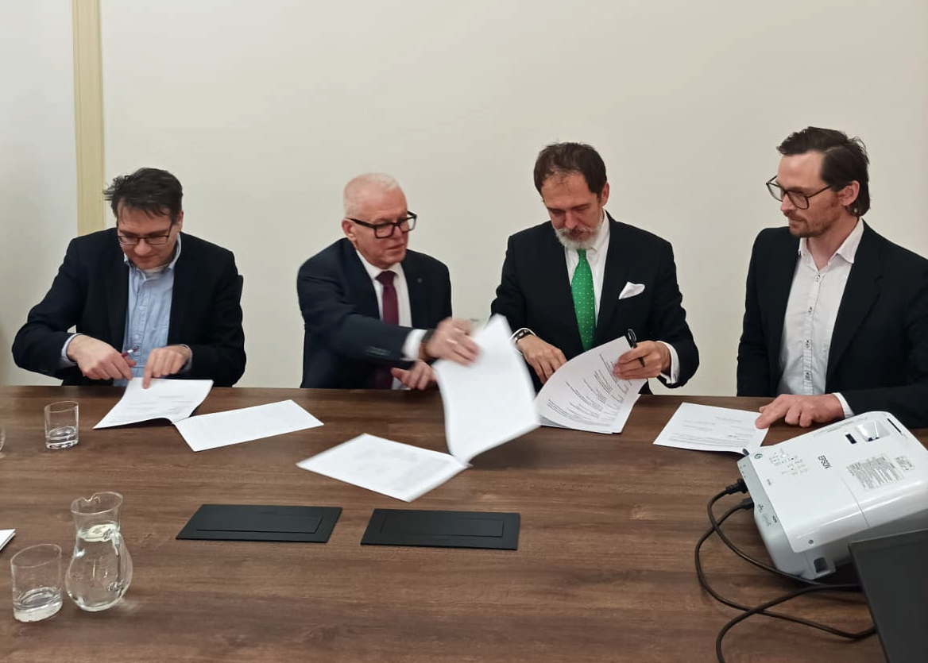
2020 Feasibility Study
Listen Local Apps
Local content-aware recommenders
Educational application
2023 Memorandum of Understanding
2024 Slovak Music Dataspace

Slide 4




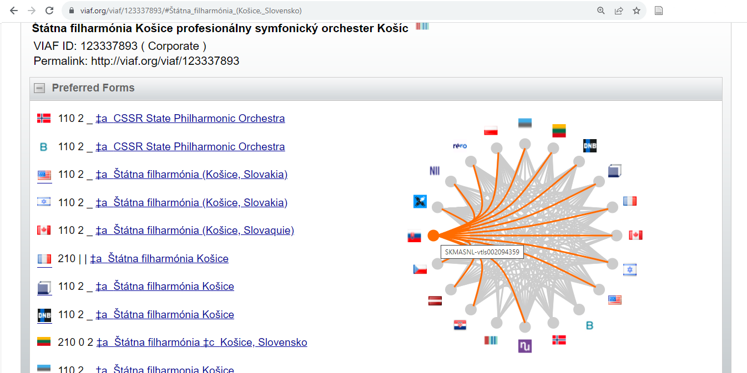
Coordination of protected and public data in a private Wikibase.
Public interest microdata, digital objects and dataset release coordination.
Digital Music Observatory
data coordination
Ensure public authority control (f.e. VIAF) of improved and more complete data.
Update private authoritative sources like CISAC’s IP/ISWC.

Slide 5
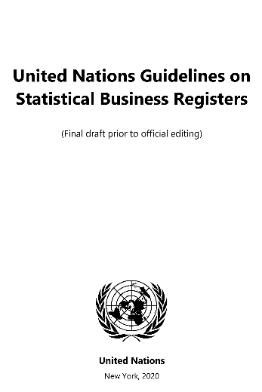

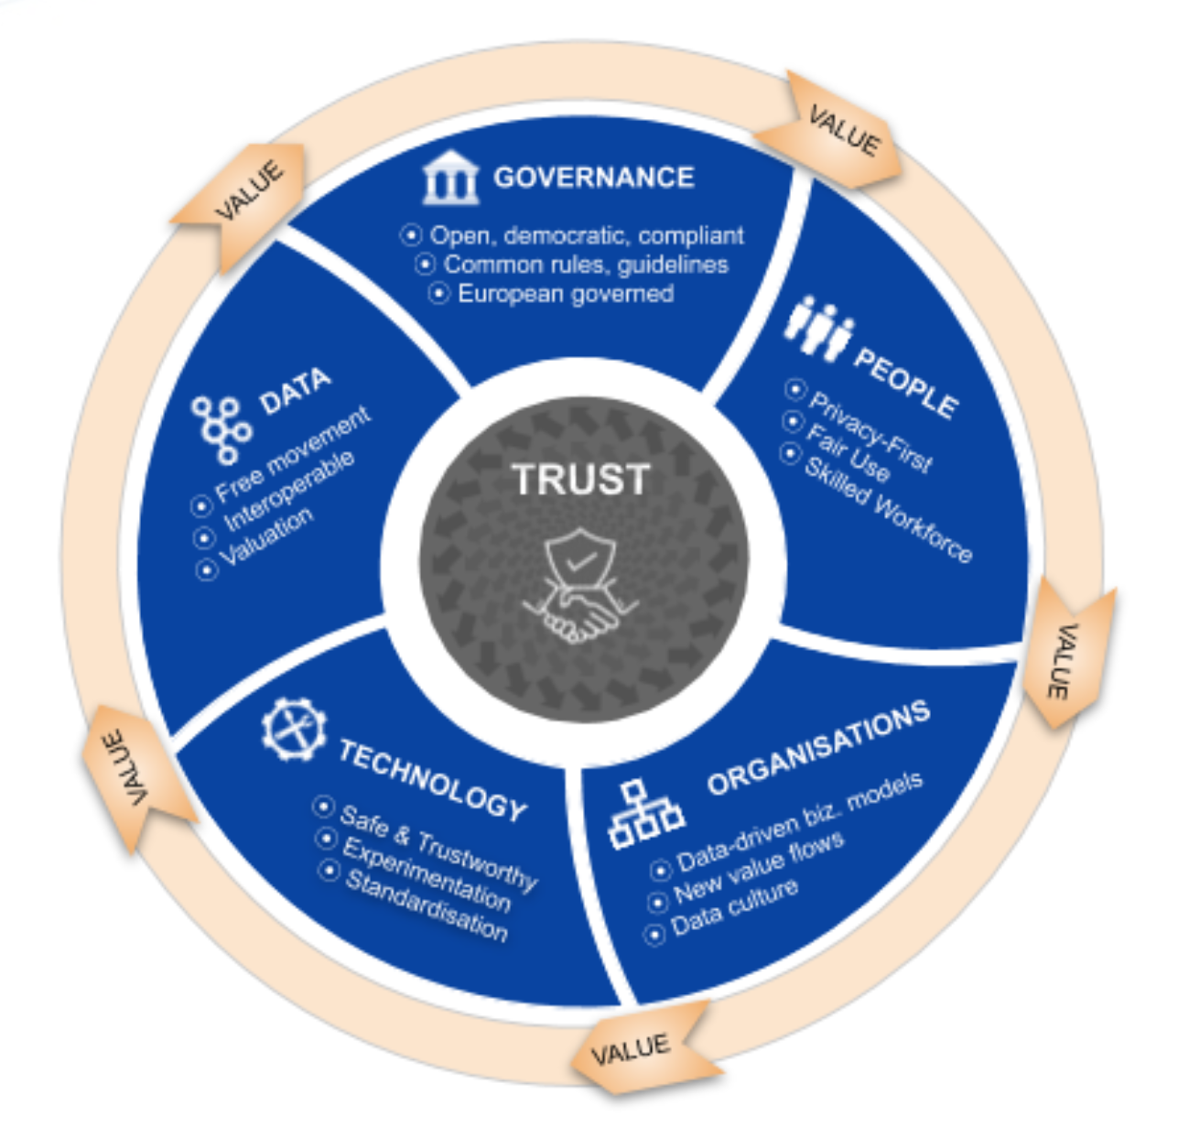



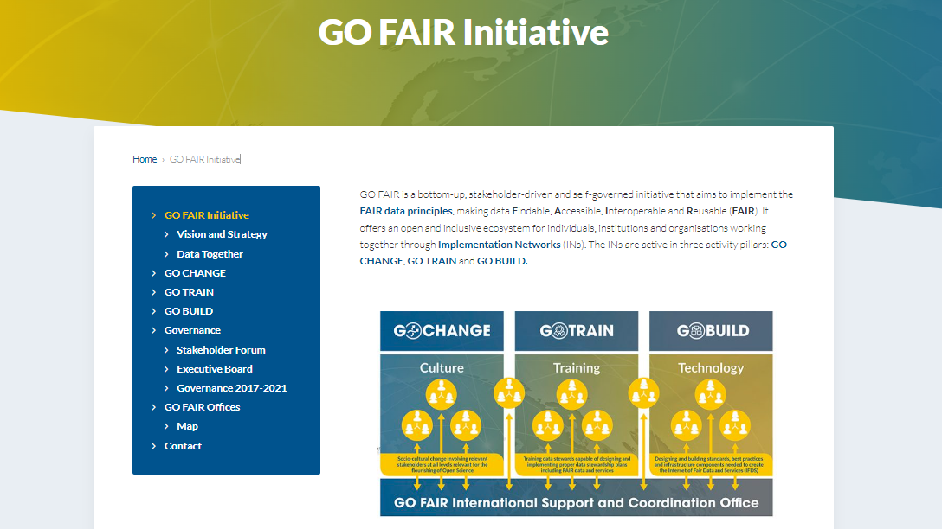
Intellectual property and metadata
Statistics &
administrative data
Open science data
Library & archive data

Slide 6



Questions?
Music and film data, observatory stakeholder network
openmuse.eu/ reprex.nl/contact www.linkedin.com/in/antaldaniel

